Slide 1
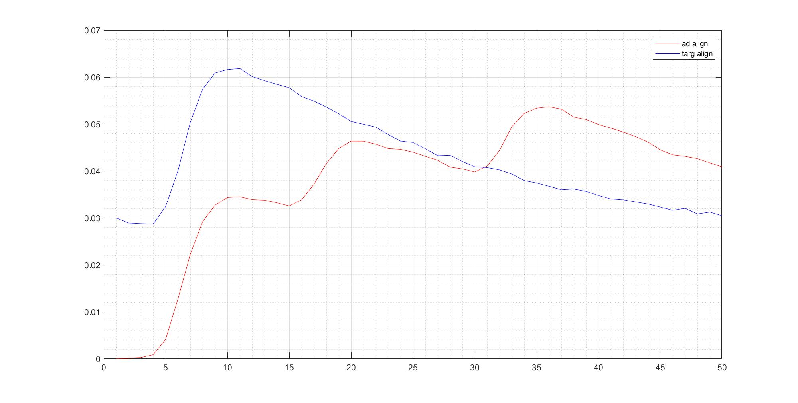
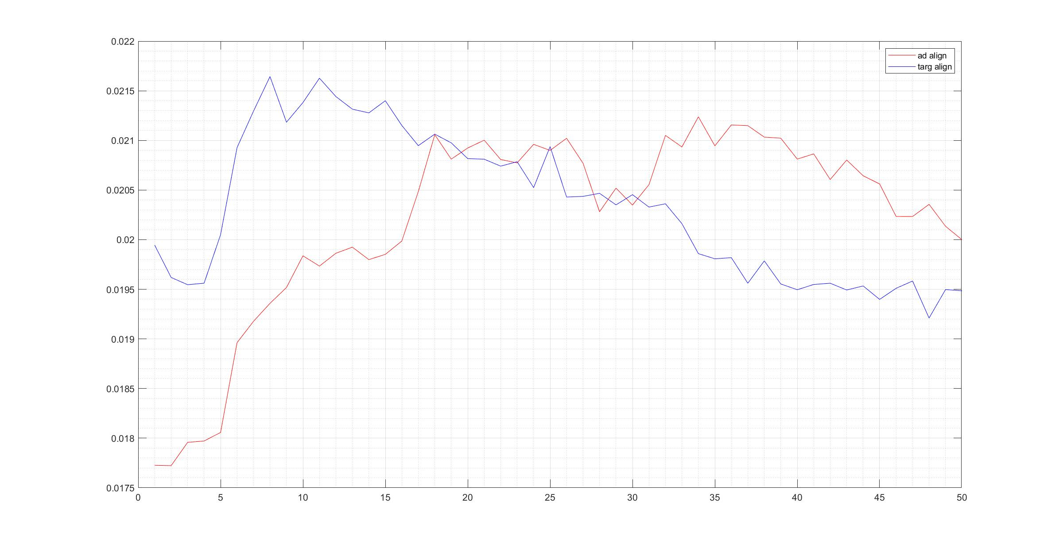
grating V1_ i1329_201209
Manual segment
Caiman segment (all cells, not just vis driven)

Slide 2
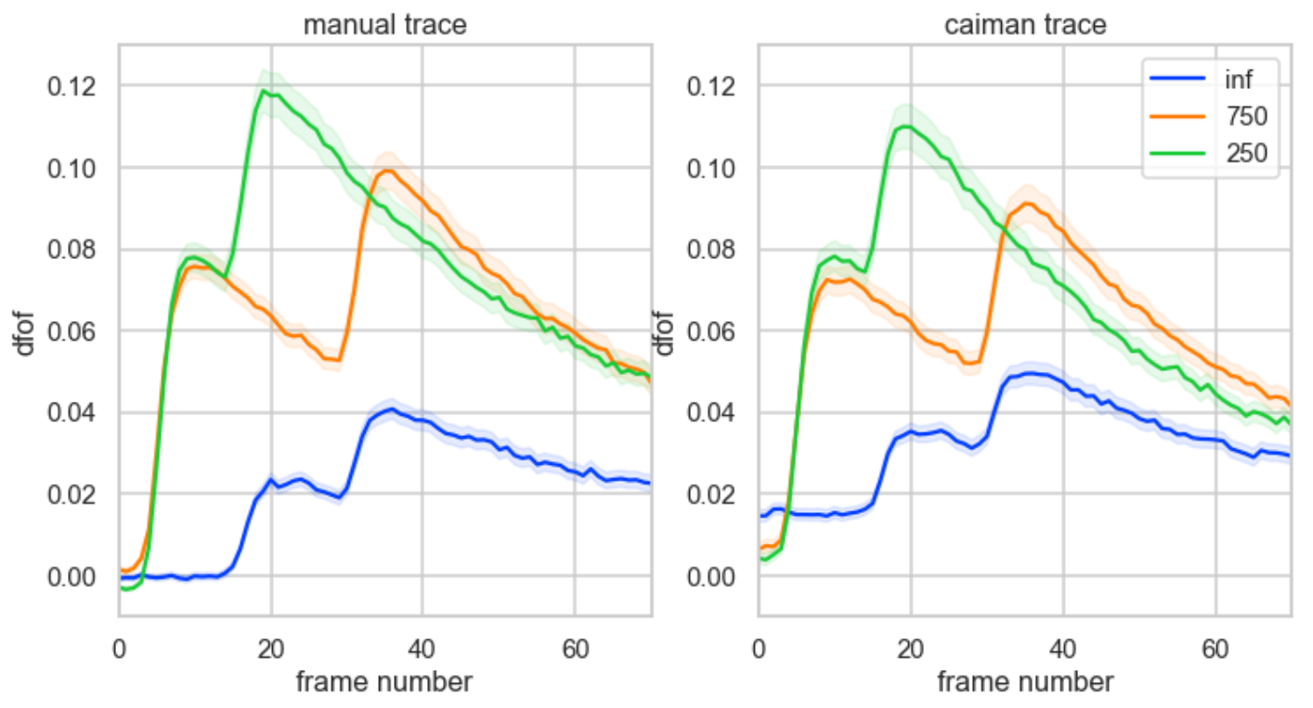
grating V1_ i1329_201209 vis driven only

Slide 3
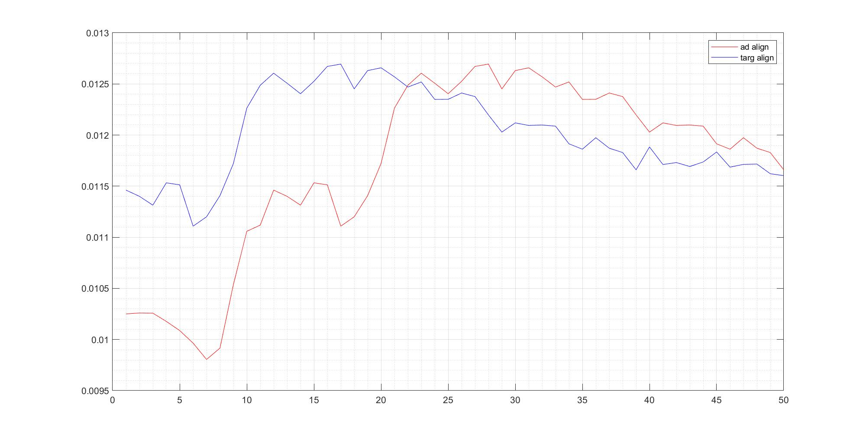
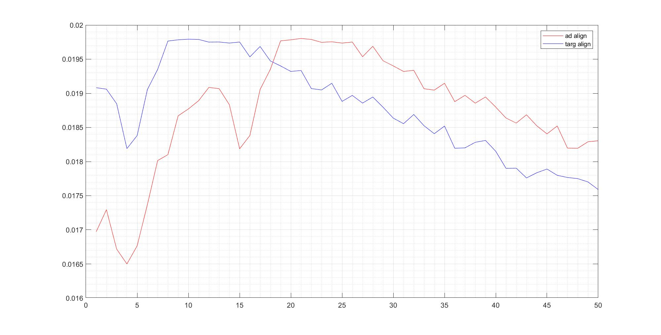
bunny500 V1_i1339_210922_caiman bunnytop V1_i1350_211222_caiman

Slide 4
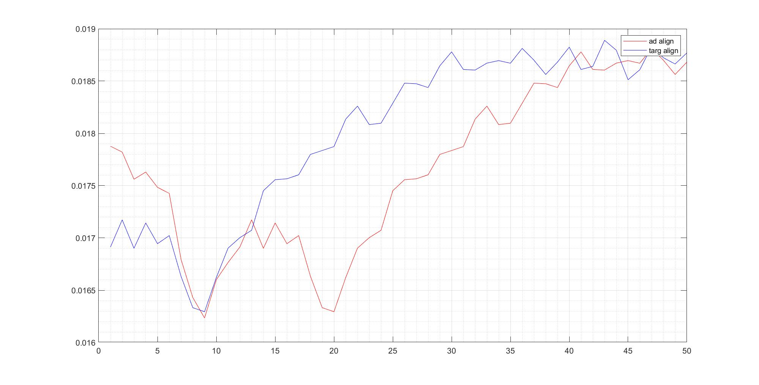
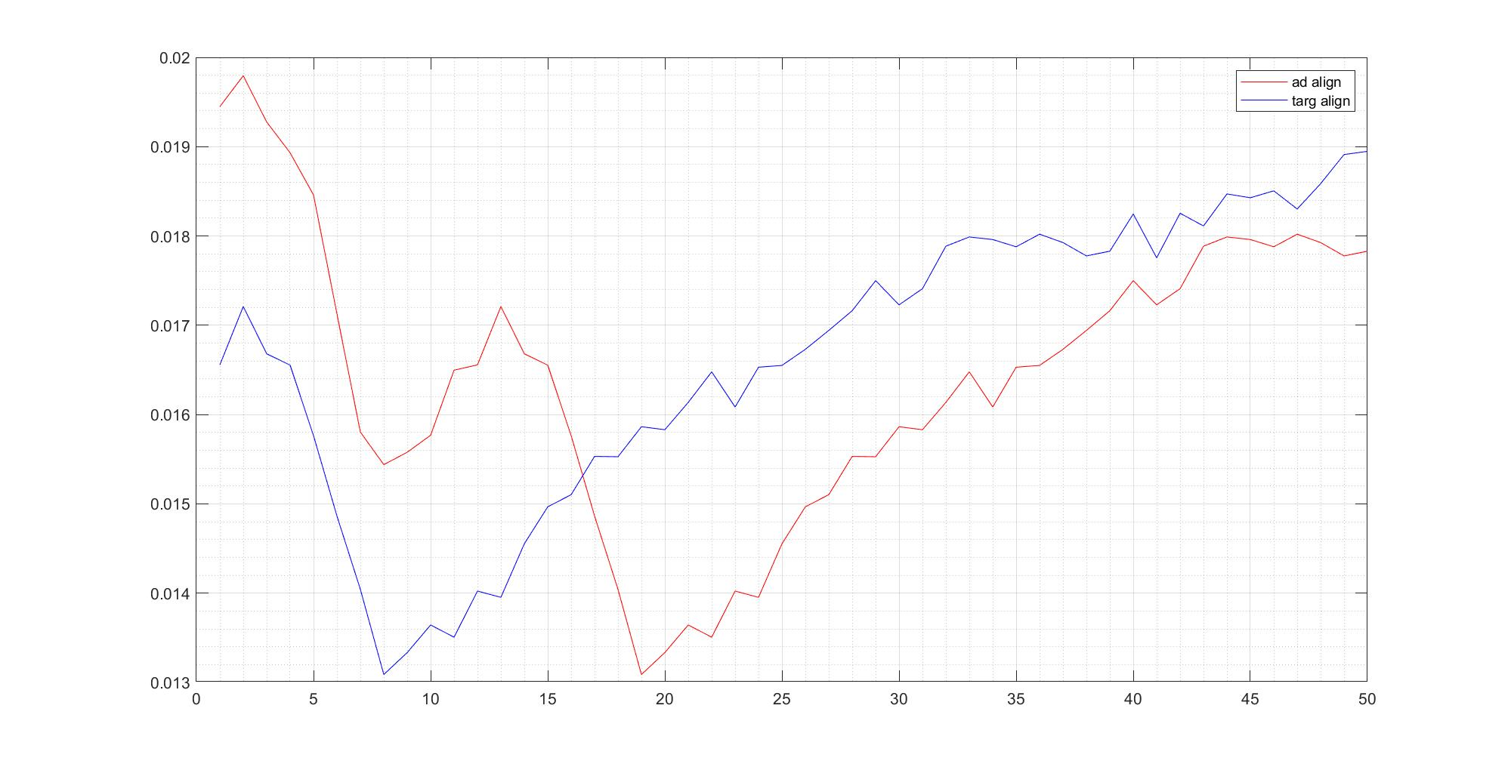
bunnytop LM_i1350_220124_caiman bunnytop V1_i1350_220225_caiman

Slide 5
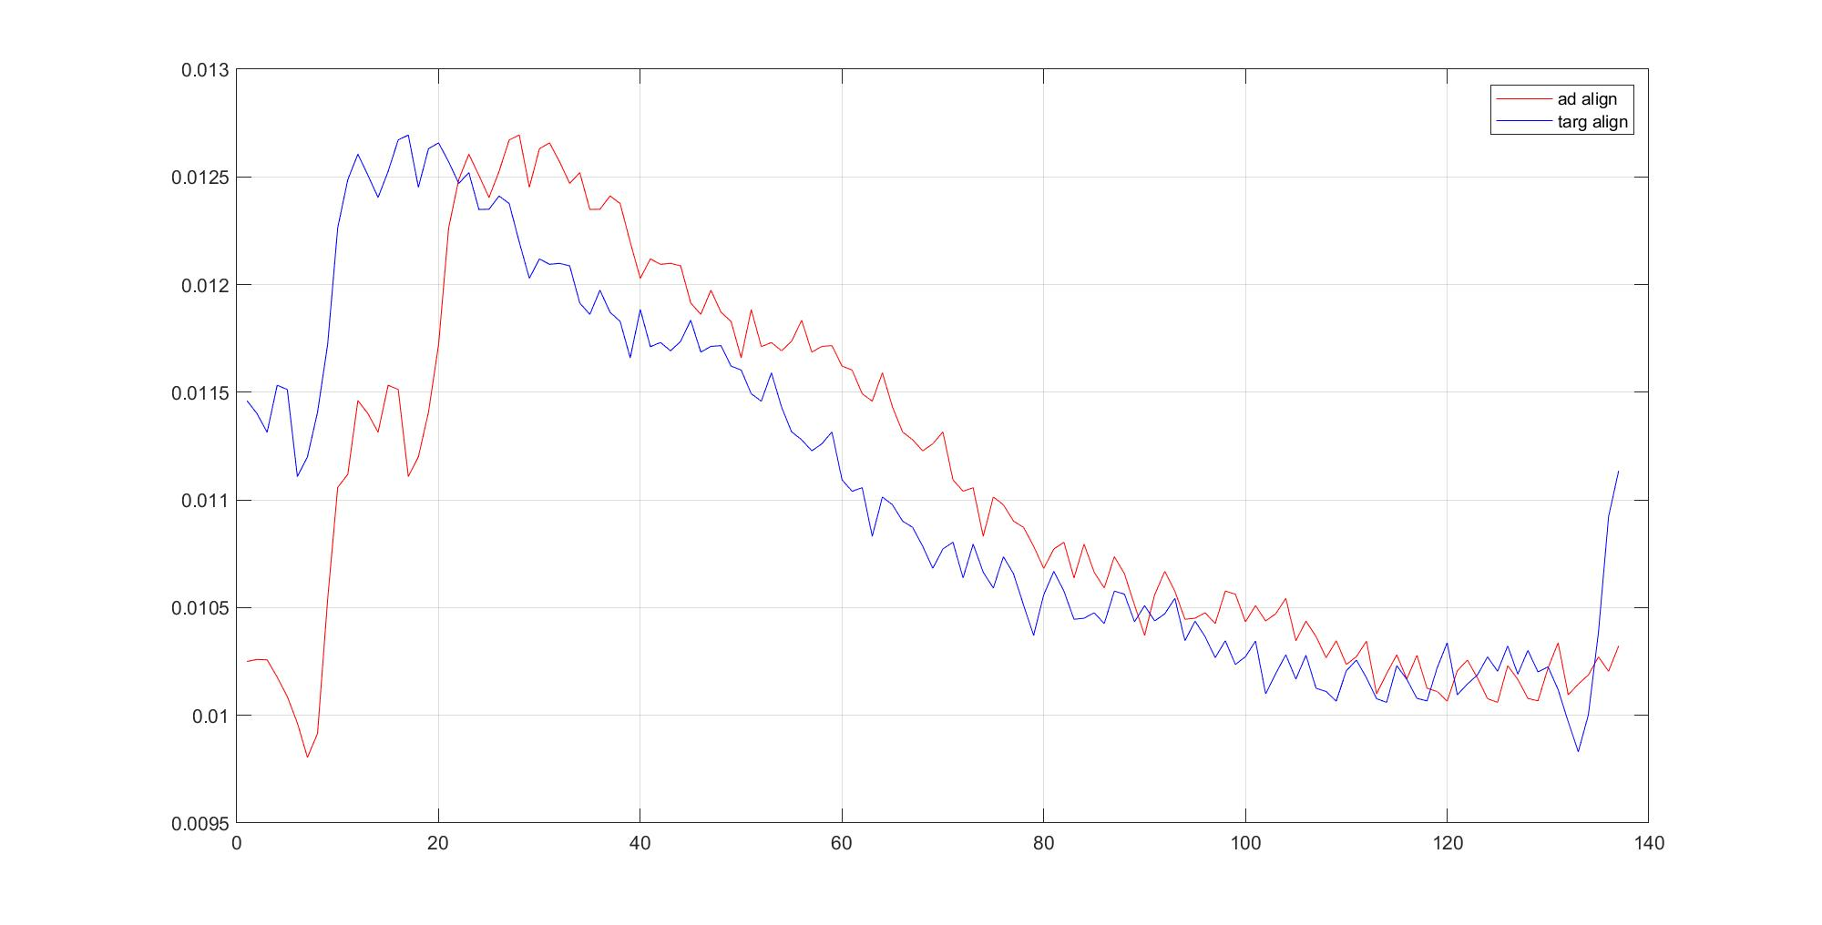
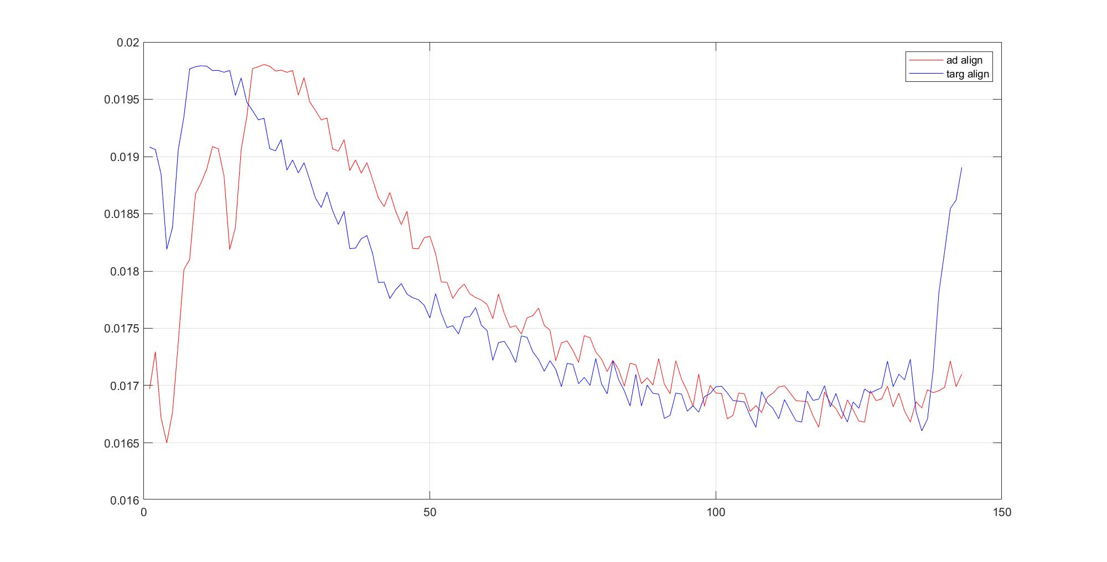
bunny500 V1_i1339_210922_caiman bunnytop V1_i1350_211222_caiman

Slide 6
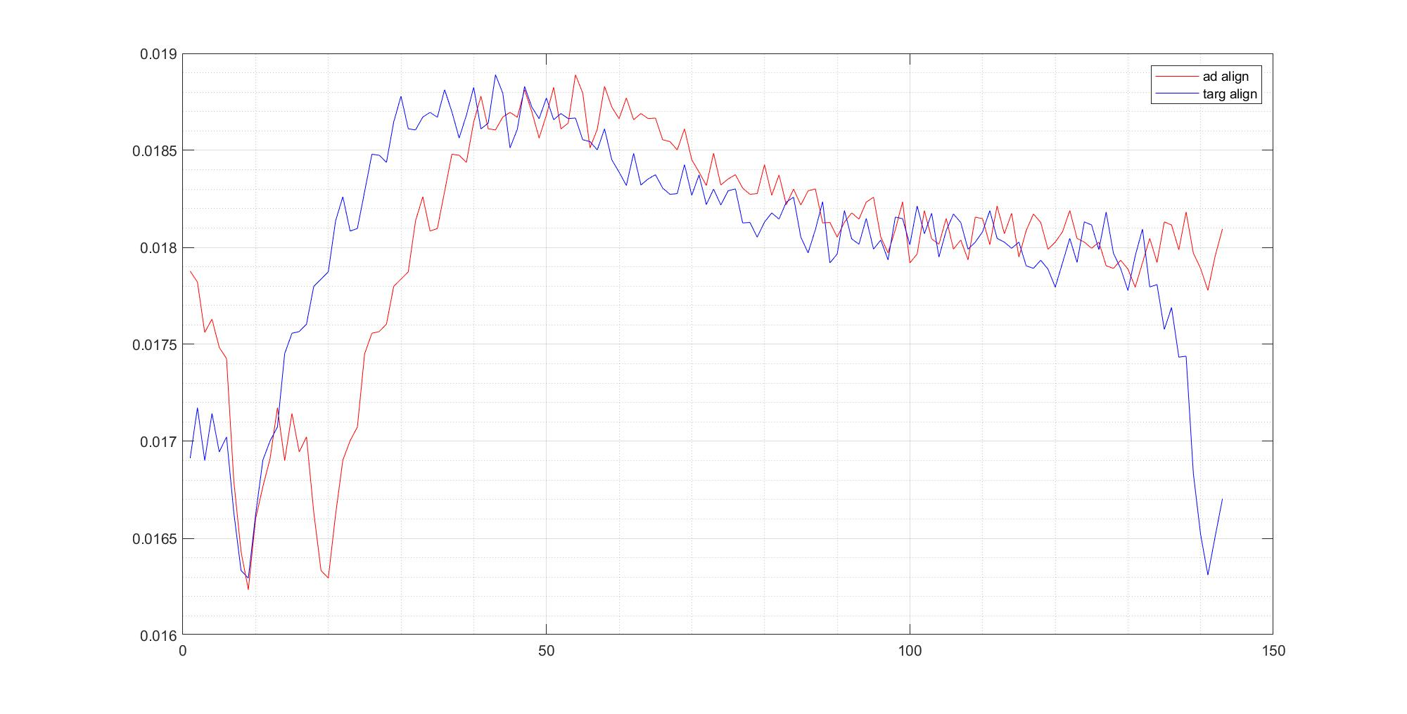
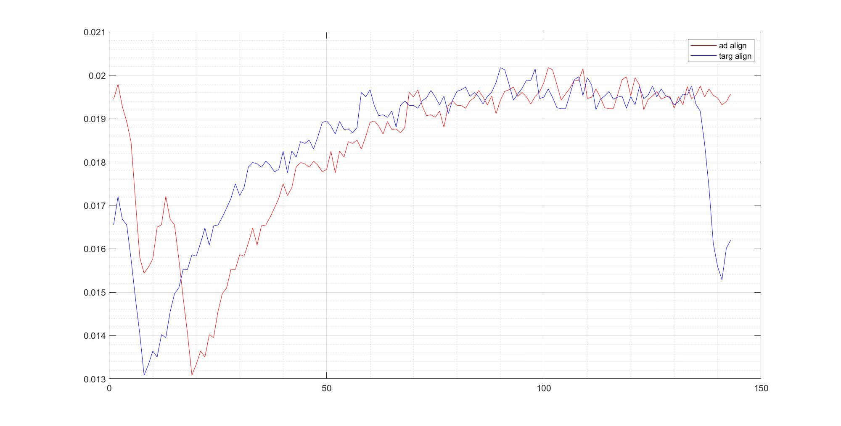
bunnytop LM_i1350_220124_caiman bunnytop V1_i1350_220225_caiman

Slide 7
weird trace (LM & V1_high_res ), markedly diff from caiman grating i1329, but manual grating i1329 is same as caiman -> caiman is not malfunctioning?
dip at stim onset only appears for natural img, not grating -> nat img causes the dip?
last 2 dataset from i1350 (LM & V1_high_res) doesn't have typical vis resp -> should change mouse

